Slide 1
Health Awareness and Nutrition: Basic Terms and Definitions
Department of Clinical Nutrition and Dietetics College of Health Sciences

Slide 2
Nutrition Science and Art
Nutrition is an interdisciplinary science that intercourses with other applied and human sciences
The Science of Nutrition
Food science, biochemistry, genetics, physiology, microbiology, molecular biology, immunology, pathology, pharmacology, medicine
Nutritional Traditions and Behaviors
Human sciences, food believes, ethnic effects, psychology, religion, sociology
Food Production and Economy
Salary, input, national economy, food security, food processing, transportation, marketing
Nutrition Art and Science
Communication
Education, language, governmental agencies, NGOs, mass media

Slide 3
Basic Terms and Definitions
Nutrition: the science of foods and the nutrients and other substances they contain and its relationship with health. It is concerned primarily with body growth, development and maintenance
Food: products derived from plants or animals that can be taken into the body to yield energy and nutrients for the maintenance of life and the growth and repair of tissues
Diet: the food and beverages that a person regularly eats and drinks. Diet could be Normal (regular) or therapeutic (modified)

Slide 4
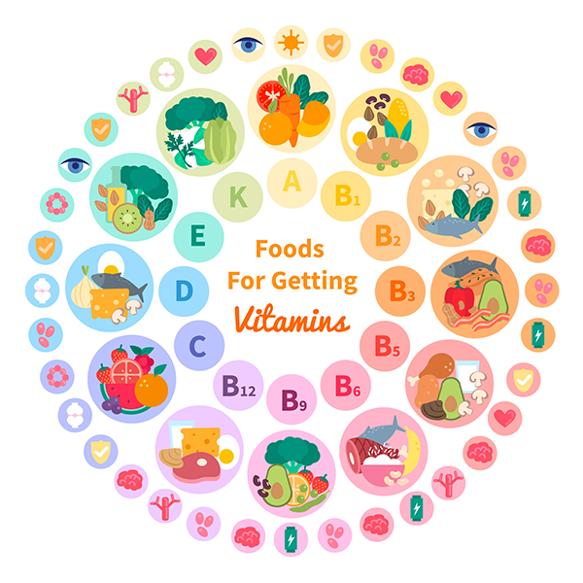
Basic Terms and Definitions
Nutrients: chemical substances obtained from food and used in the body to provide energy, structural materials, and regulating agents to support growth, maintenance, and repair of body tissues.

Slide 5

Basic Terms and Definitions
Functional foods:
food that contain physiologically active compounds that provide health benefits beyond their nutrient contributions, sometime also called designer foods, medical foods, or Nutraceuticals
Examples include: fruits and vegetables, whole grains, probiotics, fiber , and fortified foods and beverages and some dietary supplements

Slide 6

Basic Terms and Definitions
Functional foods:
Phytochemicals: non-nutrient compounds found in plant-derived foods that have biological activity in the body which and may have health effects.
Examples include: flavonoids, curcumin, and carotenoids.

Slide 7
Basic Terms and Definitions
Criteria for classifying nutrients:
Required by the body on a daily basis to perform a specific physiological functions
Required in a specific quantity
The absence of the nutrient will lead to developing deficiency symptoms and signs
Those deficiency symptoms could not be covered unless the body is provided with that nutrients, not any other nutrients

Slide 8
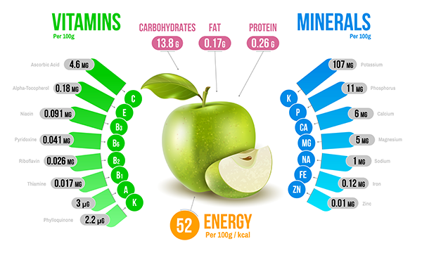
Basic Terms and Definitions
Essential Nutrients: nutrients a person must obtain from food because the body cannot make them for itself in sufficient quantity to meet physiological needs, also called indispensible nutrients. About 40 nutrients are currently known to be essential for human beings
Non-essential Nutrients: nutrients that the body can make them for itself in sufficient quantity to meet physiological needs, also called dispensable nutrients

Slide 9



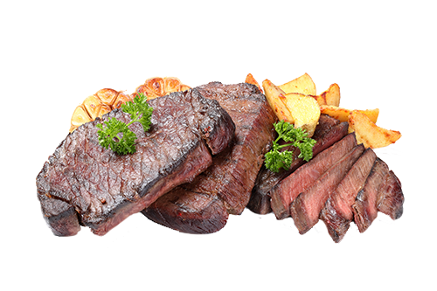


Nutrients in Foods and in the Body
Composition of foods includes the six nutrient classes of:
Water
Carbohydrates
Lipids
Proteins
Vitamins
Minerals

Slide 10
Basic Terms and Definitions
 |  | Carbon | Hydrogen |  | Oxygen | Nitrogen | Minerals
Inorganic nutrients
Minerals |  |  |  |  |  |  |  |  | ✔
Water |  |  |  | ✔ | ✔
Organic Nutrients
Carbohydrate |  | ✔ |  | ✔ | ✔
Lipids (Fats) |  | ✔ |  | ✔ | ✔
Proteins |  | ✔ |  | ✔ | ✔ | ✔
Vitamins |  | ✔ |  | ✔ | ✔

Slide 11
Composition of Food
Food
Organic
Inorganic
Nutrient: carbohydrates, proteins, fats, vitamins
Non nutrients: Photochemical, pigments, additives, & chemical residues (pesticides, herbicides …)
Minerals
(Nutrient minerals and non-nutrient minerals such as heavy metal toxicants)
Water

Slide 12
Nutrients
Divided into two categories:
Energy Producing Nutrients: (Macronutrients)
Carbohydrates
Proteins
Lipids
Essential Non-caloric Nutrients (Micronutrients)
Vitamins
Minerals

Slide 13
Macronutrients and Micronutrients
Macronutrients:
Carbohydrate, fat, Water, and protein are macronutrients because the body needs them in large quantities
Energy-yielding nutrients:
the nutrients that breakdown to yield energy the body can use: Carbohydrate, protein and fat

Slide 14
Macronutrients and Micronutrients
Micronutrients:
Vitamins and minerals do not provide energy and the body needs them in smaller quantities.
They have important roles in the energy producing processes and other body building processes

Slide 15

Basic Terms and Definitions
Energy: the capacity to do work
The energy in food is chemical energy. The body can convert this chemical energy to mechanical, electrical, or heat energy

Slide 16

Basic Terms and Definitions
Calories: units by which energy is measured
Food energy is measured in Kilocalories (1000 calories equal 1 kilocalorie), abbreviated kcalories or kcal
One Kcalorie is the amount of heat necessary to raise the temperature of 1 Kg of water 1 Cº
The scientific use of the term kcalorie is the same as the popular use of the term Calorie

Slide 17


Energy content
Kilocalorie (kcal)
- Carbohydrate = 4 kcal/g
- Protein = 4 kcal/g
Fat = 9 kcal/g
Alcohol = 7 kcal/g
Kilojoule (kJ): the metric value
- Carbohydrate = 17 kJ
- Protein = 17kJ
- Fat = 38 kJ
- Alcohol: = 30 kJ

Slide 18

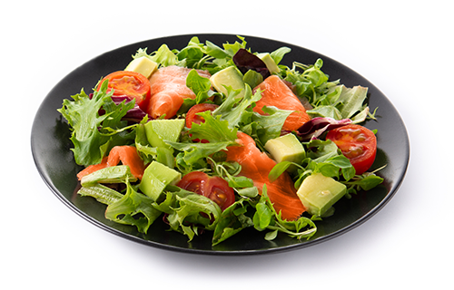
Energy From Food
It is the number of calories (energy) in a specific amount of food
Energy density: a measure of the energy a food provides relative to the amount of food (kcalories per serving)
High energy density means that there are a lot of calories in small amount of food
Low energy density means that there are fewer calories in small amount of food

Slide 19

Nutrient Density
The relationship between Calories and Nutrients is called nutrient density
Refers to the amount of nutrients provided relative to the number of Calories
Foods with high nutrient density are nutritious
Foods with low nutrient density are not healthy

Slide 20

Of these 2 breakfasts which one has higher energy density?

Slide 21
Lower energy density
This 450-gram breakfast delivers 500 kcal, for an energy density of 1.1 (500 kcal/450 g = 1.1 kcal/g)
Higher energy density
This 144-gram breakfast delivers 500 kcal, for an energy density of 3.5 (500 kcal/144 g = 3.5 kcal/g)

Slide 22
Energy Requirements
Each individual requires a specific amount of food, depending on their energy requirements
Estimated Energy Requirement (EER): It takes into account your age, sex, weight, height, and physical activity level (PA)
The energy requirement is defined as the amount needed to maintain health, growth, and an “appropriate” level of physical activity

Slide 23



Energy Requirements
Digestion: Thermic Effect of Food
Physical Activity
Basal Metabolism
+
+
Total Energy Expenditure
=

Slide 24


Pathways for Energy in the body
Energy for activity
Stored energy

Slide 25



Energy Balance
Healthy Eating
=
Being Active
Calories In
Calories Out
Energy Imbalance
=
Too Much
Too Much
Food
Stored Fat

Slide 26
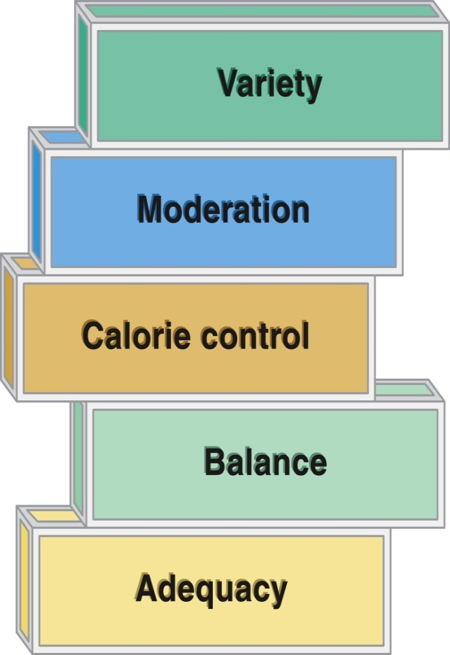
Characteristics of a Healthy Diet
Calorie Control: An appropriate amount of Calories are eaten to maintain a healthy body weight
Adequacy: diet contains a quantity adequate to maintain health
Balance: Food types complement one another in the diet. Not any one nutrient or food type is overbearing
Moderation: The diet does not contain an excess or deficient in one or more of the food groups or nutrients
Variety: Different foods are used for the same purpose in the diet

Slide 27

Factors Affecting our Food Choices
Hunger: The Physiological need for food. The physical body sends signals indicating a need for food
Satiety: The Physiological feedback mechanisms that terminate food intake
Appetite: The Psychological desire for food. The brain sends signals indicating a desire for food because of sensory input like seeing, smelling, or thinking about food

Slide 28
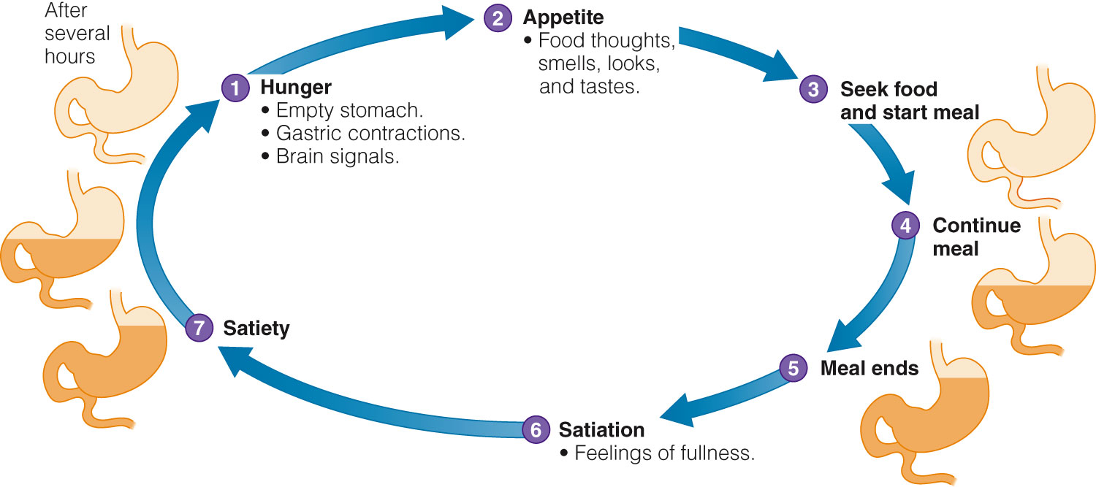
Factors Affecting Hunger, Appetite and Satiety

Slide 29

Factors Affecting Food Choices
Personal Preferences: The food likes and dislikes of an individual
Availability: Food supply, geographical area, climate, soil
Economics: Social status and income
Social Factors: Family, friends, holidays, celebrations, etc

Slide 30
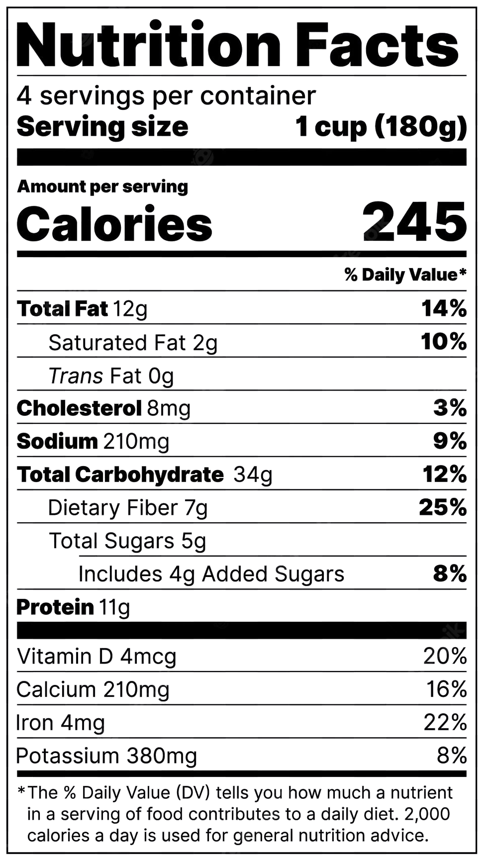
Factors Affecting Food Choices
Advertising: TV, radio, magazines, newspaper
Nutritive values: nutrient and energy content
Other: feelings, Emotions, knowledge, etc.

